Slide 1
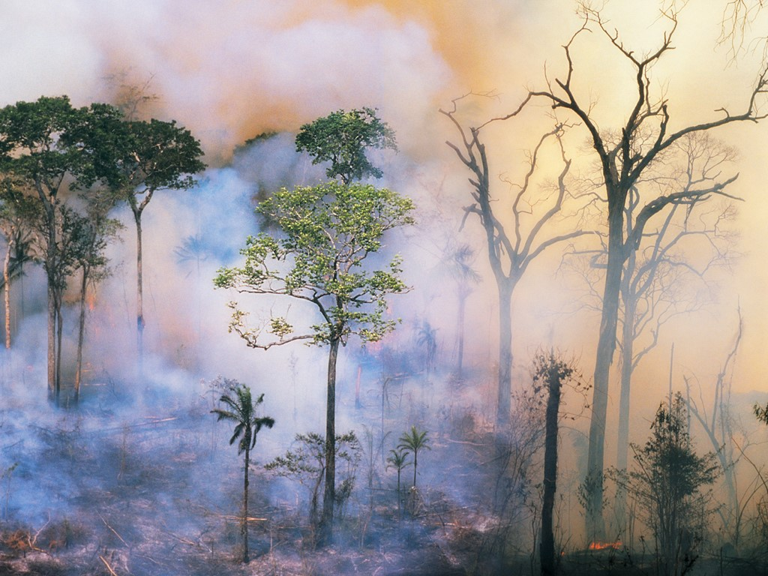
FIRE SMOKE FOREST IDENTIFICATION USING CNN
NURAINI AZIZAH

Slide 2
TABLE OF CONTENTS
01
02
03
BACKGROUND & PROBLEM
DATA COLLECTION
METHODOLOGY
04
05
MODELLING
CONCLUSION

Slide 3
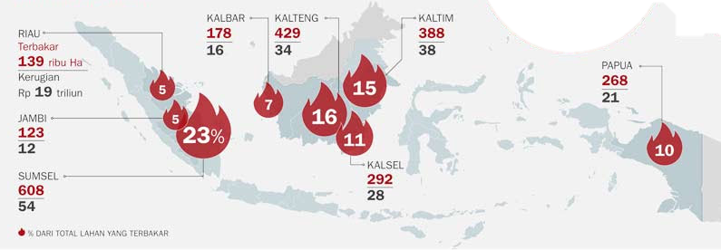
BACKGROUND & PROBLEM
Fire-forest is a serious environmental hazard in Indonesia
Forest-fires have a real threat to human lives, environmental systems and infrastructure, and it is predicted could destroy half of the world's forests by the year 2030.
One of efficient way to minimize the forest fire damage is adopt early fire detection mechanisms based on image processing.
The aim of the project is to identify and model forest fire so as classifying fires using input images.

Slide 4
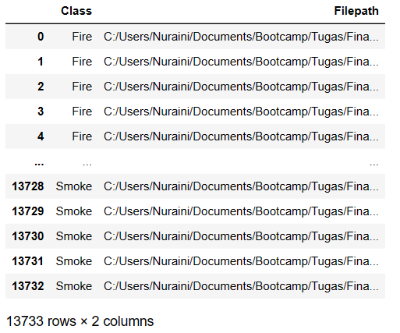
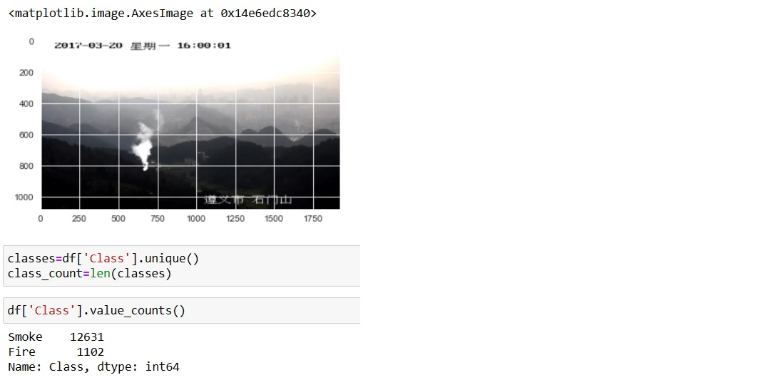
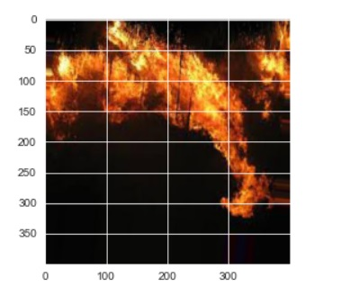
DATA COLLECTION
Preview Dataset
The images were collected from Kaggle Forest Fire Dataset.
It is divided into two categories : Fire and Smoke.
Total images of each category is 1102 for fire and 12631 for smoke.
This dataset needs through preprocessing for handling imbalance and different size.

Slide 5
METHODOLOGY
Handle Imbalance & Different Size
Create Model
Evaluate and Save Model
CNN (Convolutional Neural Network) Sequential model is used to identify and predict image classification.
Here are steps in process modelling:
Split Dataset and Create Generator
Train Model
Predicting

Slide 6
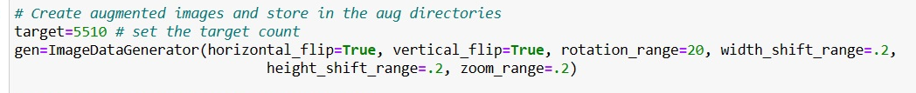
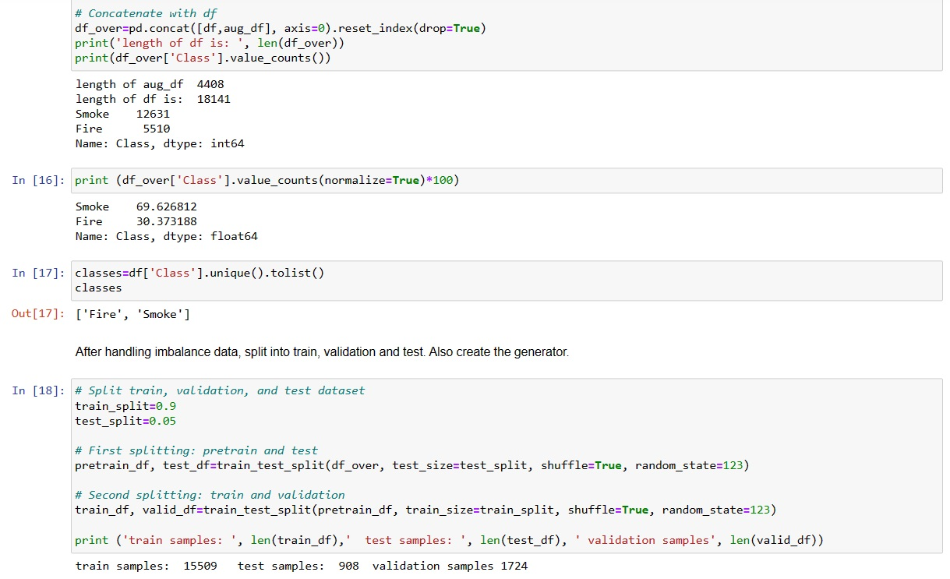
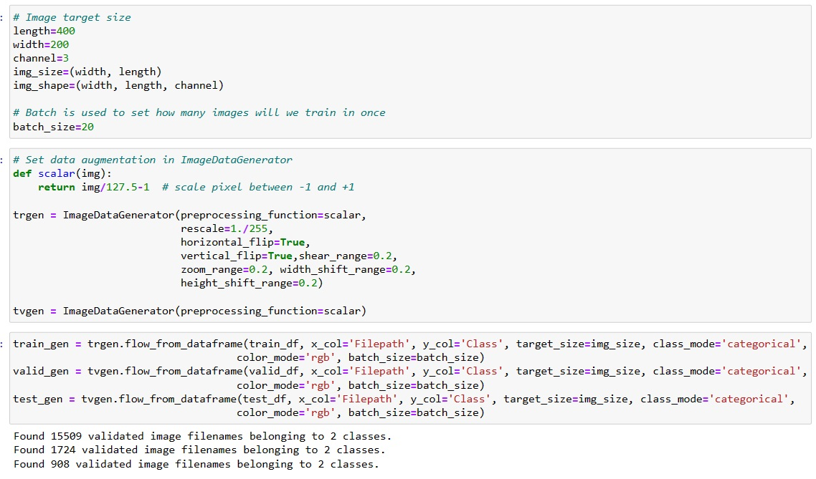
DATA PRE-PROCESSING
Imbalance Dataset
Split Dataset

Slide 7
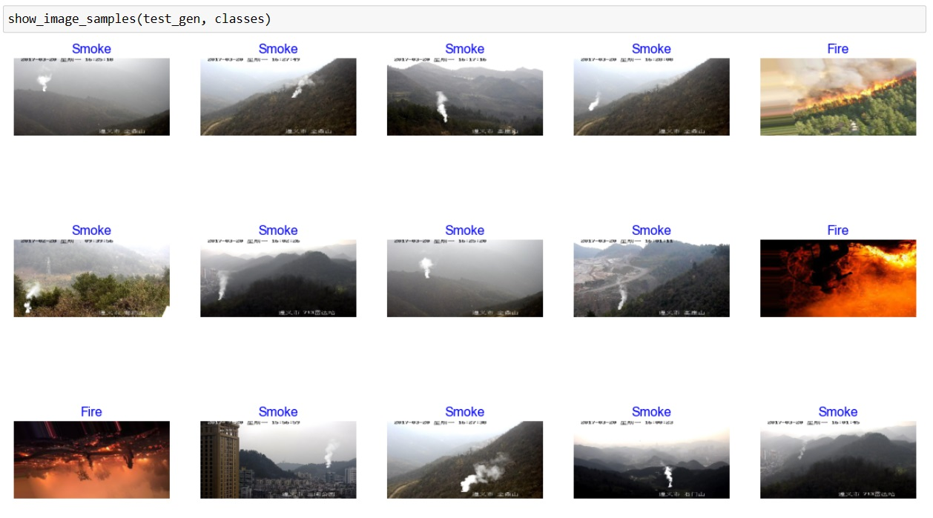
DATA PRE-PROCESSING
Sample Images

Slide 8
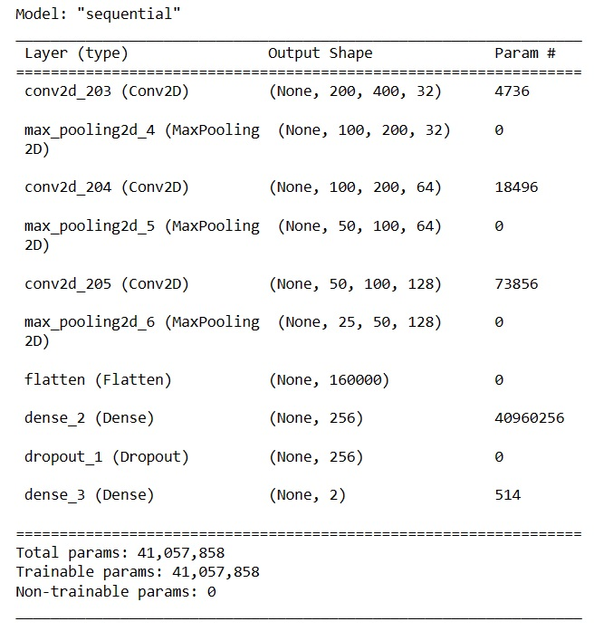
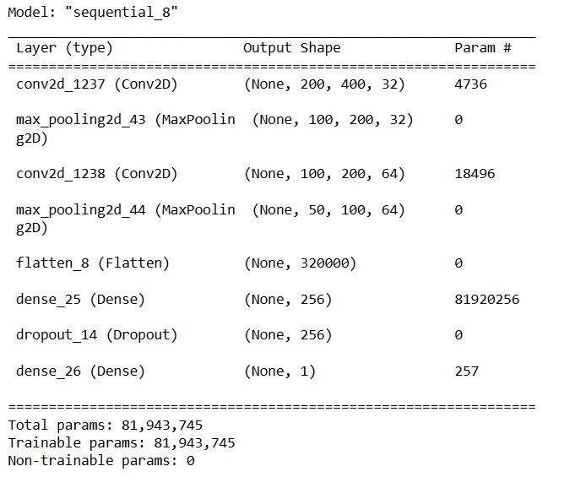
MODELLING
SATURN
2 Layers + Dropout
3 Layers + Dropout
70:30 Dataset
Saturn is the ringed one. It’s a gas giant, composed of hydrogen and helium. It’s named after the Roman god of agriculture

Slide 9
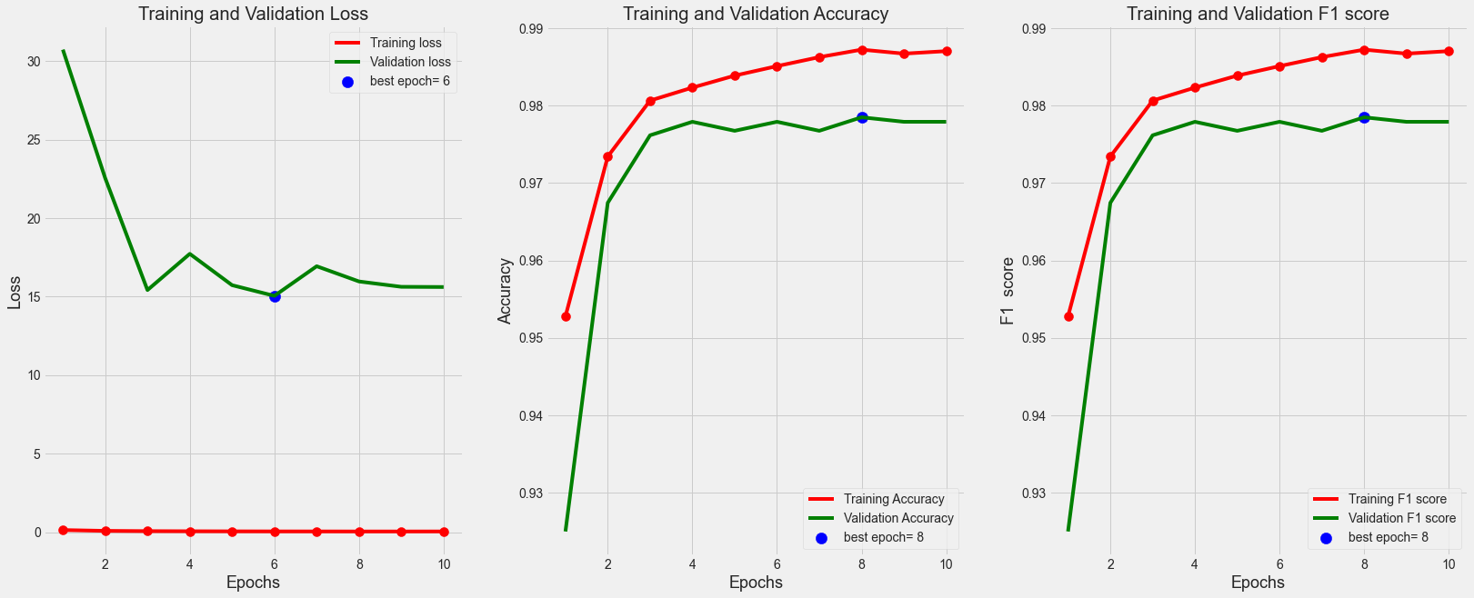
MODELLING
70:30 Dataset
2 Layers + Dropout

Slide 10
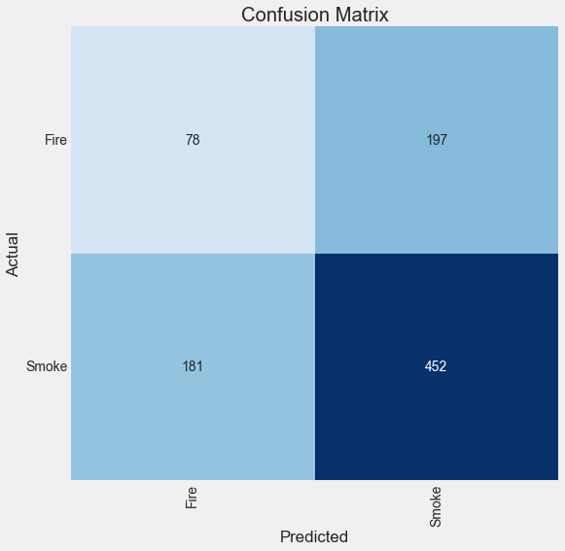

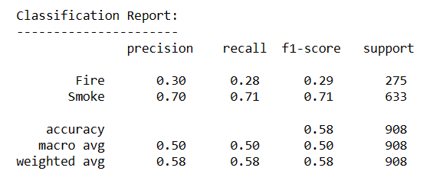
MODELLING
70:30 Dataset
Evaluation Result
Prediction Result

Slide 11
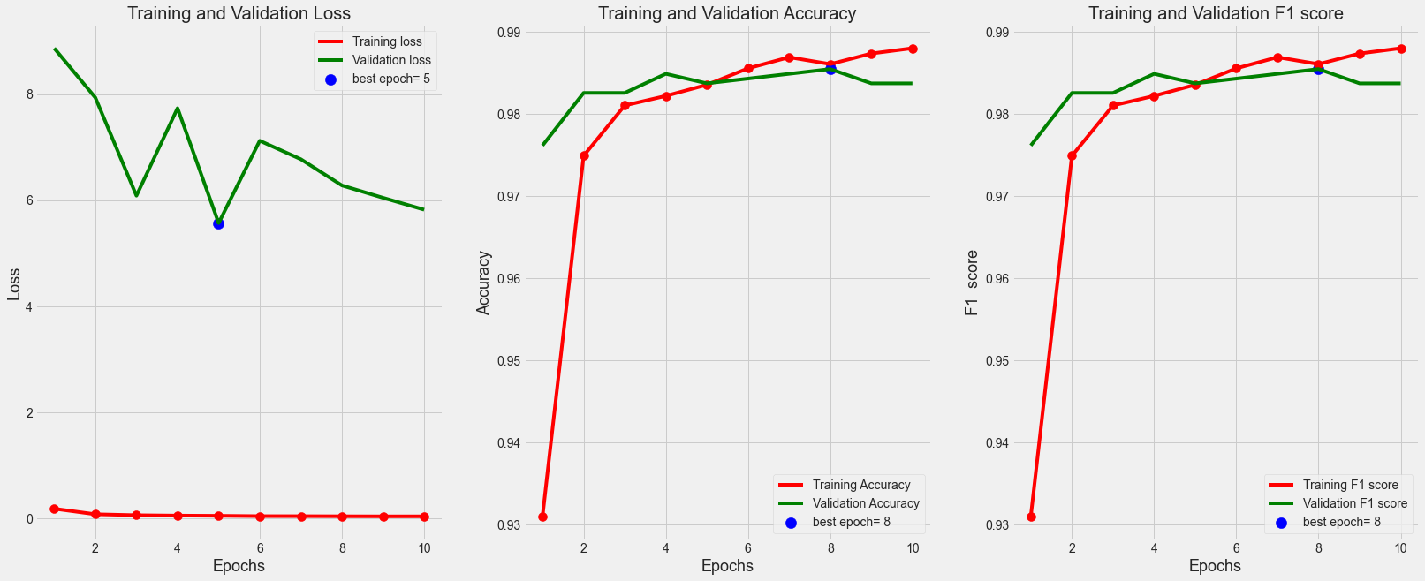
MODELLING
70:30 Dataset
3 Layers + Dropout

Slide 12

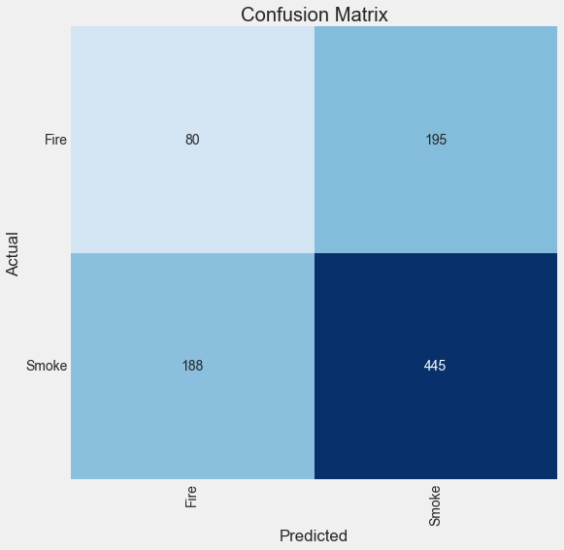
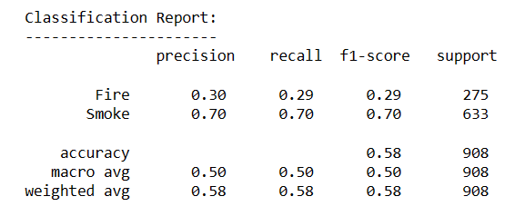
MODELLING
70:30 Dataset
Evaluation Result
Prediction Result

Slide 13
CONCLUSION & RECOMENDATION
CNN Sequential can be used for modelling image classification.
From 908 images, the model can predict the pictures with F1 Score 58%.
For the next analysis, amount of layer must be considered and use combination of regularization and drop out for handling overfitting.

Slide 14
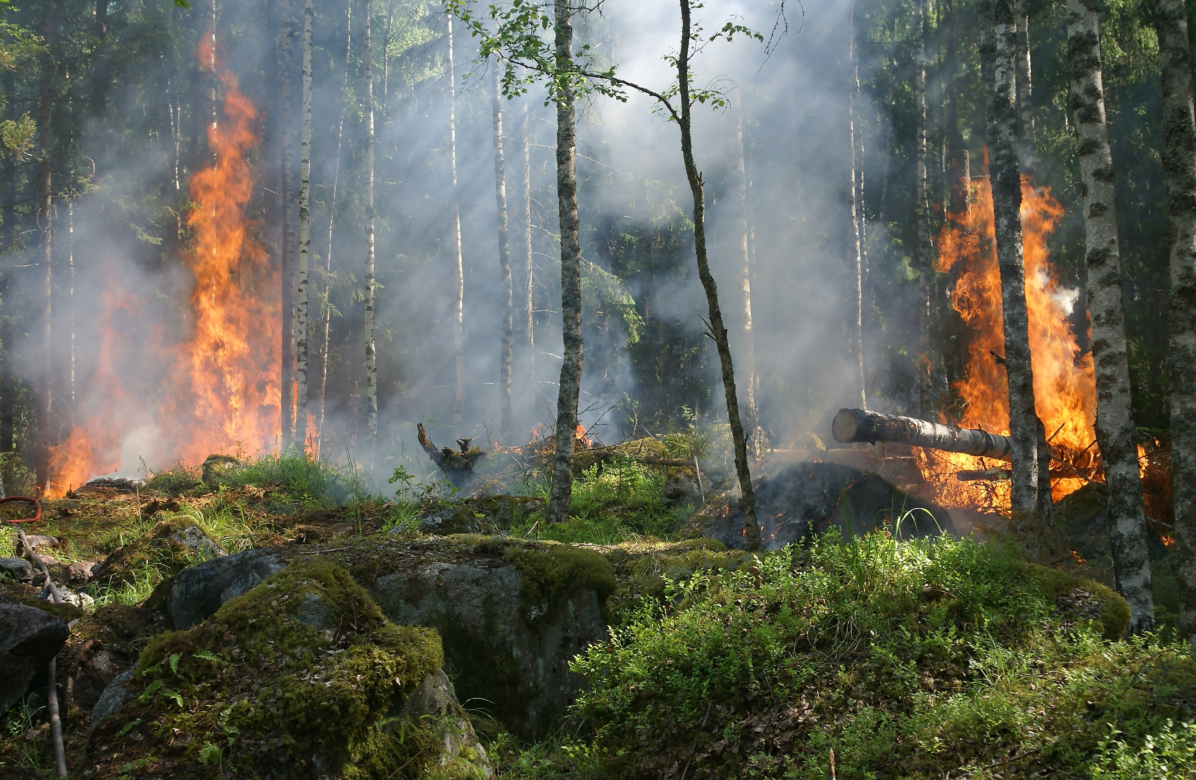
THANK YOU
azizah.nuraini17@gmail.com

